Slide 1


Slide 2
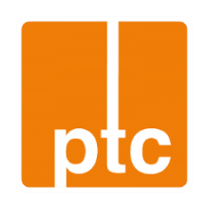
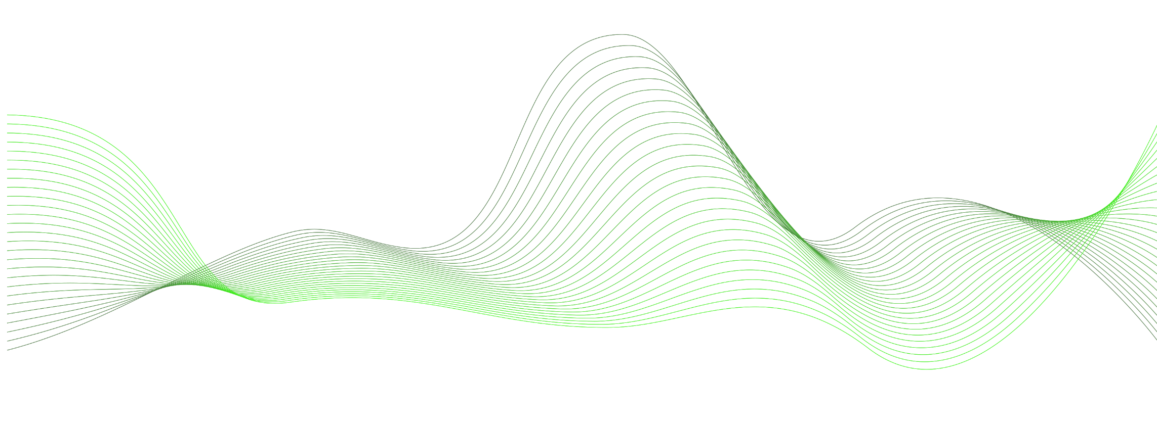

2025
GOTTSBERG Leak Detection
Optimization of pipeline safety
and return of investment at the same time.

Slide 3

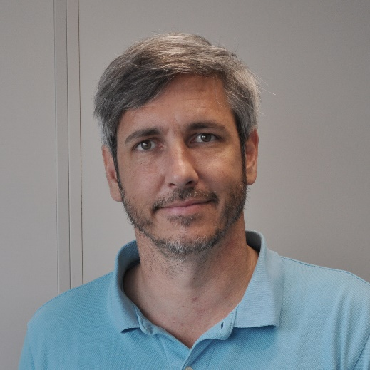
Author/ Presenter:
Rene Landstorfer
Operations Manager
GOTTSBERG Leak Detection GmbH & Co. KG
Am Knick 20
22113 Oststeinbek Germany

Slide 4
Presentation content
Company presentation
German / European leak detection regulations
Accoustic leak detection technology
Case studies
Possibel cost savings and return on investment

Slide 5
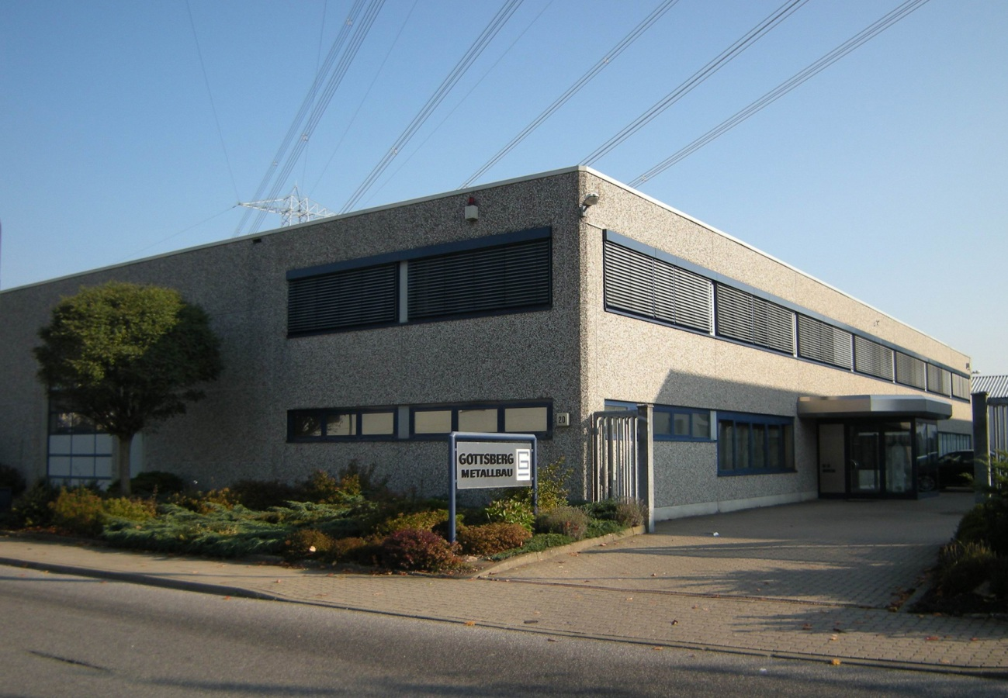
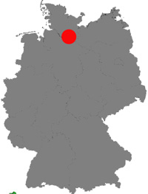
GOTTSBERG Leak Detection GmbH & Co. KG
GOTTSBERG Leak Detection GmbH & Co. KG
Founding Year: • 2006
Locations: • Oststeinbek, Germany
Certifications: • DIN ISO 9001
• DIN EN 1090
• DIN EN 18800-7
Focus on leakage detection technology R&D, manufacture and service.

Slide 6
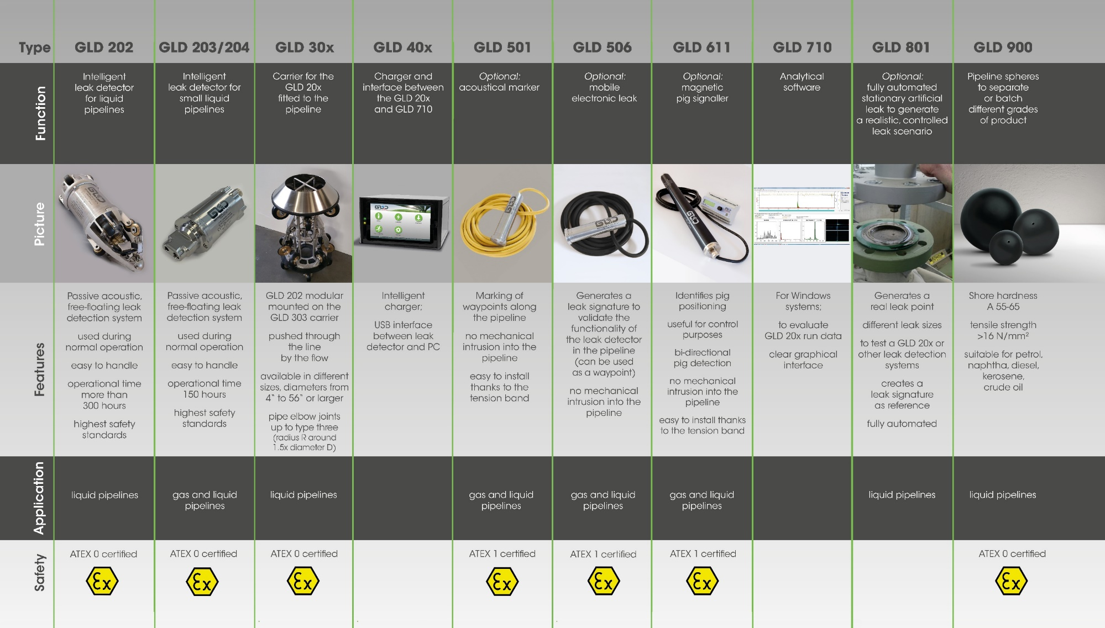
GOTTSBERG Leak Detection GmbH & Co. KG

Slide 7
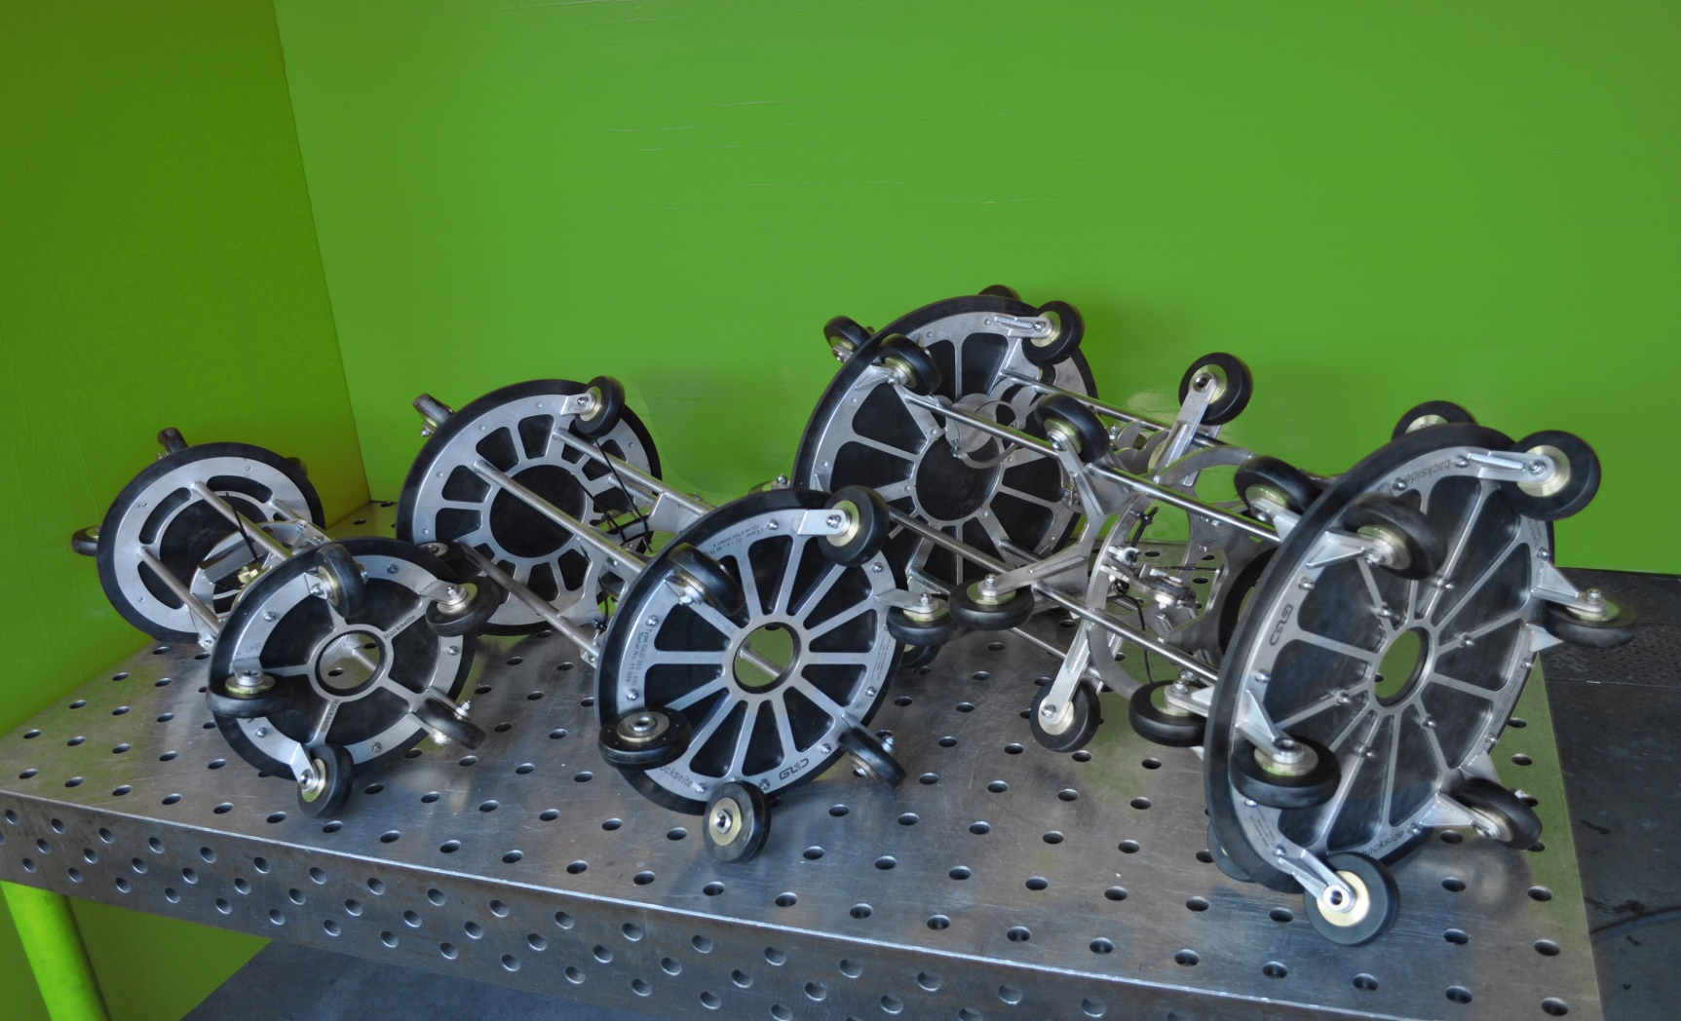
GOTTSBERG Leak Detection GmbH & Co. KG

Slide 8


Slide 9
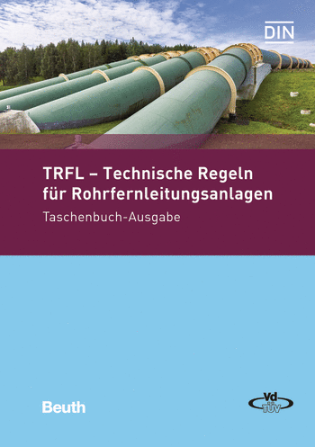
German / European leak detection regulations
In Germany the operation of leak detection systems is regulated by the TRFL (Technical Rules for Pipelines). Even though it is a national standard, it has international acceptance as for example API1175 recommendations follow the TRFL and many European countries use the TRFL for pipeline safety norms

Slide 10
TRFL (Technical Rules for Pipelines)
11.4.1.1 Two independent continuous technologies that detect leakages in steady state operation. One of them or a third one for transient conditions
11.4.1.2 Procedure to detect leaks during conveyor breaks and still stand
11.4.1.3 Detection of pihole and creeping leakages
11.4.1.4 Method that ensures the precise and quick location of any leakges

Slide 11
11.4.2 Selection of methods, detectable leaks
The methods used to detect leaking liquids are to be selected in particular with regard to Annex VII of the TRFL and their
Sensitivity (smallest detectable leakage rate and detection time)
Robustness (efficiency under unfavorable conditions)
Reliability (reliable detection without generating too much false alarms)
Accuracy of leak location
The selection must be evaluated by a standard authority.

Slide 12
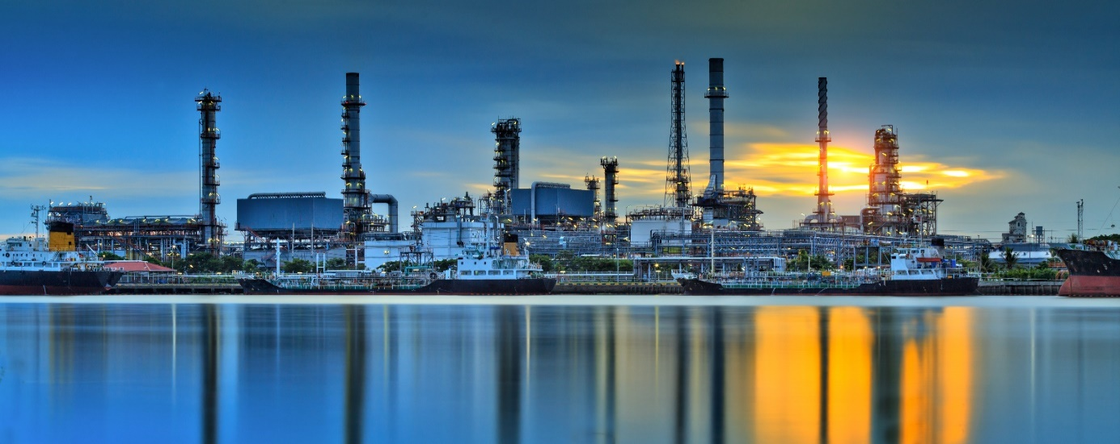

Slide 13
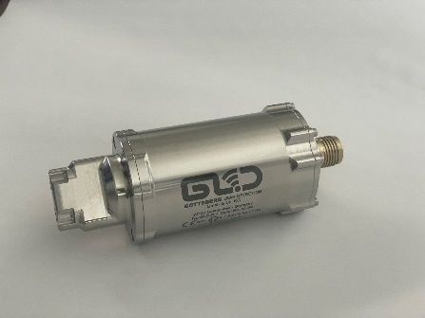
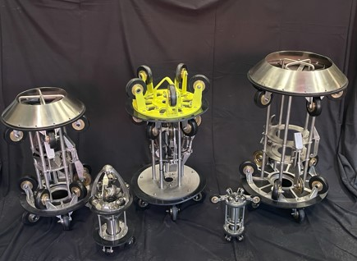
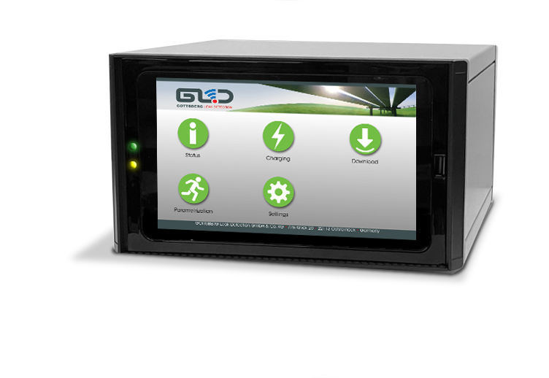
Accoustic leak detection technology
The System

Slide 14
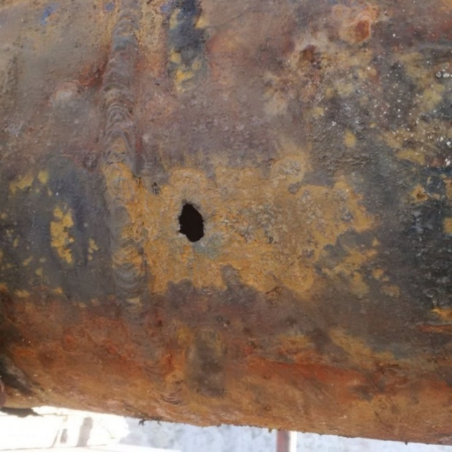
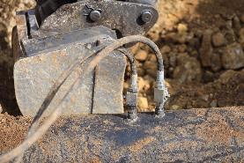
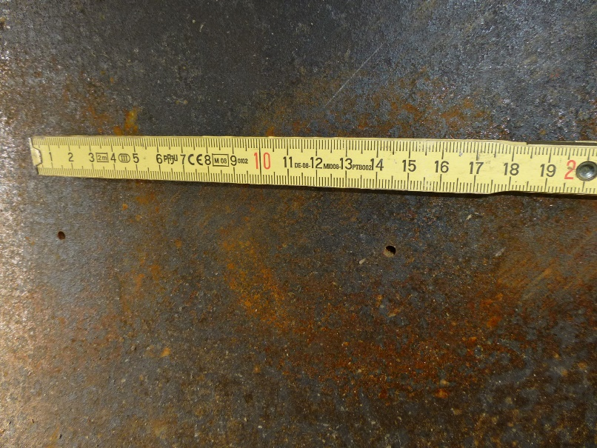
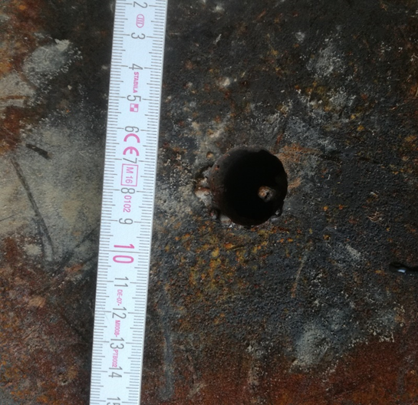
Accoustic leak detection technology
The Scope of Application

Slide 15
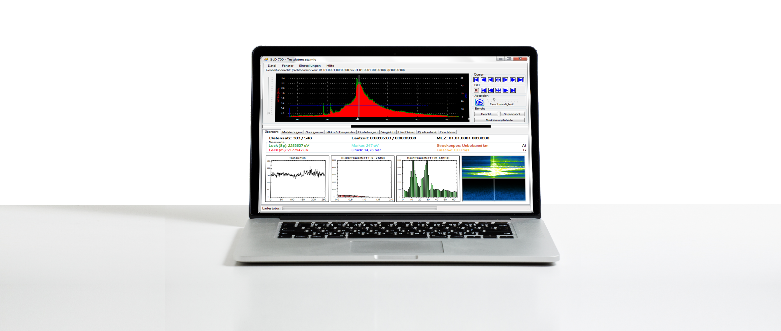
Accoustic leak detection technology
The Data Evaluation

Slide 16
Accoustic leak detection technology
The Benefits
● Only system suitable for smallest leaks (6.8 l/hr)
● Locating of the leak is done during run
● False alarms are reliably avoided with noise filters and 128 channel frequency analysis
● Run results within a few hours
● The only ILI tool certified for ATEX zone 0 (German TÜV approval)
● Operation is not affected in any way
● Can be used for several pipelines by switching the chassis
● Handling and operation is very easy

Slide 17
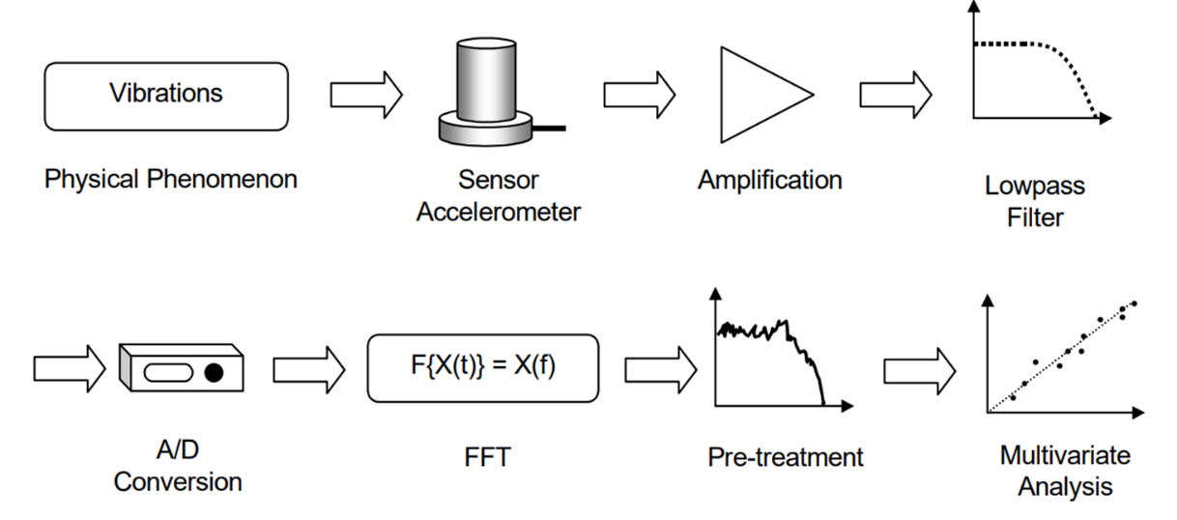
Accoustic leak detection technology
The new Developments
Increasing sensitivity to adapt to diverse environmental conditions.
Challenges: ● Receiving low distortion
acoustic signals
● Filtering noise and unwanted signals
without loosing important information
● Leveraging advanced algorithms
to evaluate complex data

Slide 18
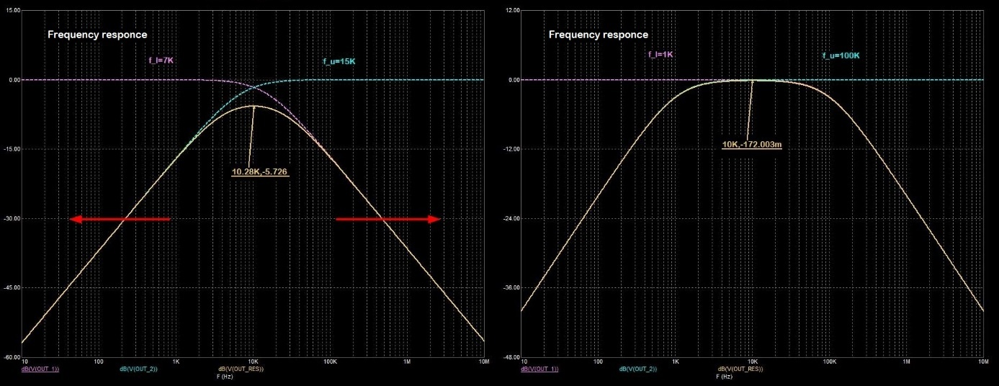
Accoustic leak detection technology
How to ensure high-quality signal processing
Challenges: ● Hydrophone selection
● Signal amplification
● Data processing
● Artificial intelligence integration

Slide 19
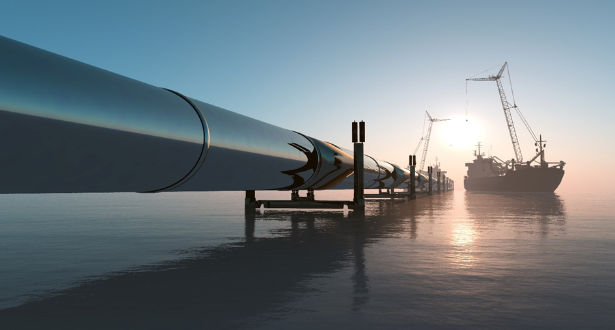

Slide 20
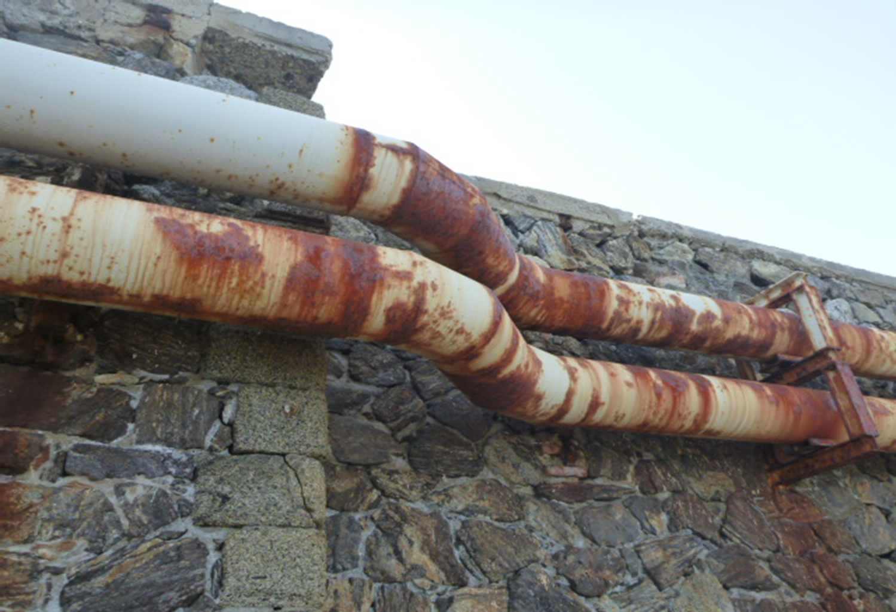
Case studies
12“ product line, Corrosion

Slide 21
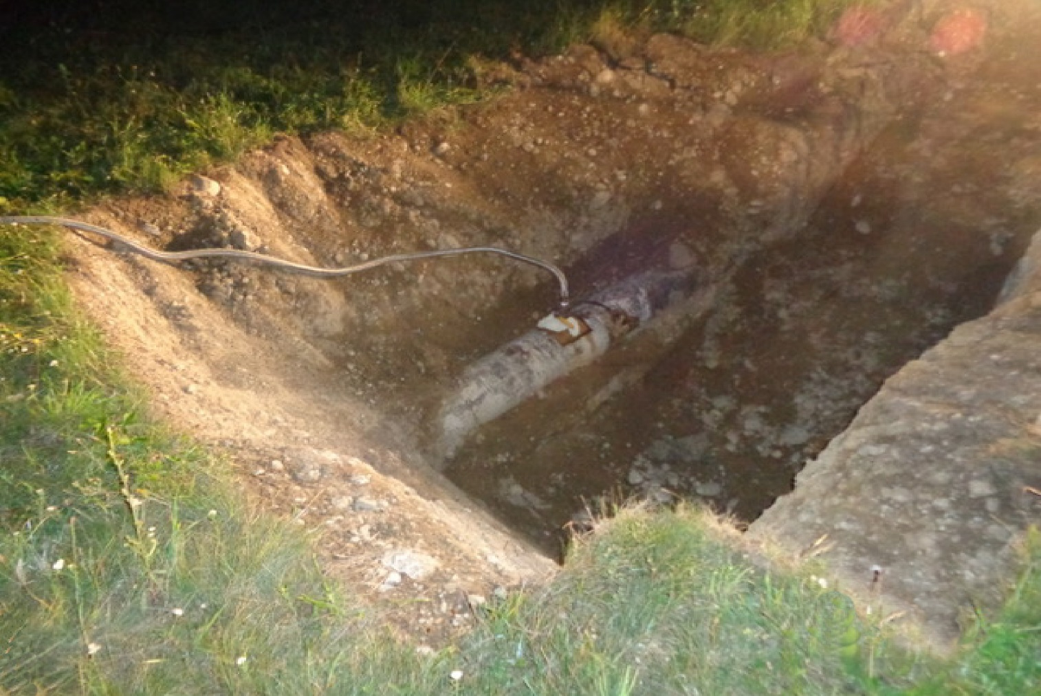
Case studies
10“ Diesel line, illegal tapping / theft

Slide 22
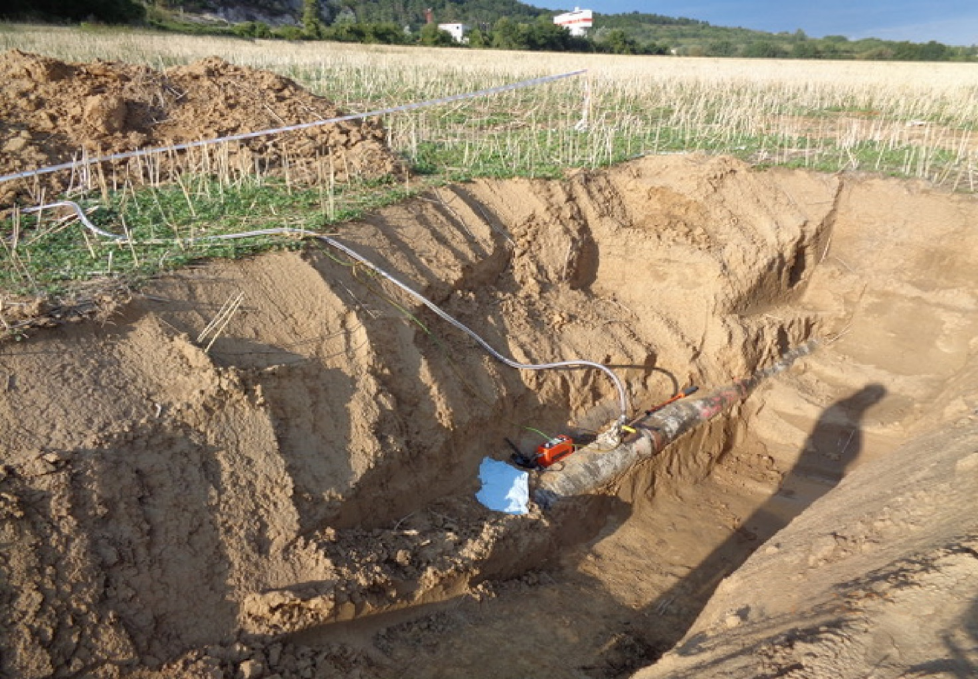
Case studies
12“ Product line, illegal tapping / theft

Slide 23


Slide 24
Cost effectiveness and return on investment
● Only system suitable for smallest leaks (6.8 l/hr)
● Locating of the leak is done during run
● False alarms are reliably avoided with noise filters and 128 channel frequency analysis
● Run results within a few hours
● The only ILI tool certified for ATEX zone 0 (German TÜV approval)
● Operation is not affected in any way
● Can be used for several pipelines by switching the chassis
● Handling and operation is very easy

Slide 25
Cost effectiveness and return on investment
How to reduce insurance costs with best possible safety?
● Which Technology combinations provide the best over-all safety
● Can any additional technology increase the pipeline safety
● Which areas along the pipeline routing require special attention or additional safety features

Slide 26
Cost effectiveness and return on investment
How to reduce costs by implementing Gottsberg Leak Detection tools?
● Reduce the frequency of intelligent pigging with leak detection tools
● Reduce downtime for e.g. pressuretests by replacing them with leak detection runs
● Which frequency of deployment of GLD technologies increases safety or decreases costs for other technologies
● The pipeline can be kept in operation as the tools do not affect it in any way

Slide 27
Cost effectiveness and return on investment
Examples from our customers
● After a major incident on a pipeline, our technology was deployed for a new customer. Some pipeline sections were now inspected on a monthly or even weekly basis. As a result, our customer was able to avoid a massive increase in premiums to their insurance company, and the potential savings far exceeded the investment costs in our technology in the first year.
● Another customer exceeded the runs requested by the standard authorities and therefore could increase the time span of requested ILI runs for corrosion and wall thickness inspections.
Additionally they replaced some Pressure-Temperature-Tests for leak detection with the GLD tools and could therefore keep the pipeline in operation for the days they would normally shut it down.

Slide 28
Thank you
for your attention!

