Slide 1


Slide 2



2024
GOTTSBERG Leak Detection
Optimizing
leak detection
strategies

Slide 3

Customised solutions for custom requirements

Slide 4
Customised solutions for custom requirements
There are many parameters that determine the quality and abilities of a leak detection technology. As there is no “one for all” system available that covers all requirements for the different operational modes and pipeline features, decisions must be made which technologies can be used and which combination leads to a maximum in safety and efficiency.

Slide 5
Customised solutions for custom requirements
There are many parameters that determine the quality and abilities of a leak detection technology. As there is no “one for all” system available that covers all requirements for the different operational modes and pipeline features, decisions must be made which technologies can be used and which combination leads to a maximum in safety and efficiency.
The presentation will cover an overlook on the most common leak detection technologies and their benefits as well as their drawbacks with a focus on the acoustic leak detection pigs of Gottsberg Leak Detection GmbH. They will be classified regarding their potential to fulfill certain points of pipeline regulations like TRFL (Germany) or API 1175 (USA). The most promising combinations of those systems that cover all possible operational modes and all pipeline features will be presented to get an idea about how the safety can be increased.

Slide 6
Additionally, there will be an outlook on the savings that can be reached by implementing these technology combinations. This will not only be the savings in loss of product or avoidance of environmental pollution but also underwriting profits and possible economies of other pipeline integrity checks.

Slide 7
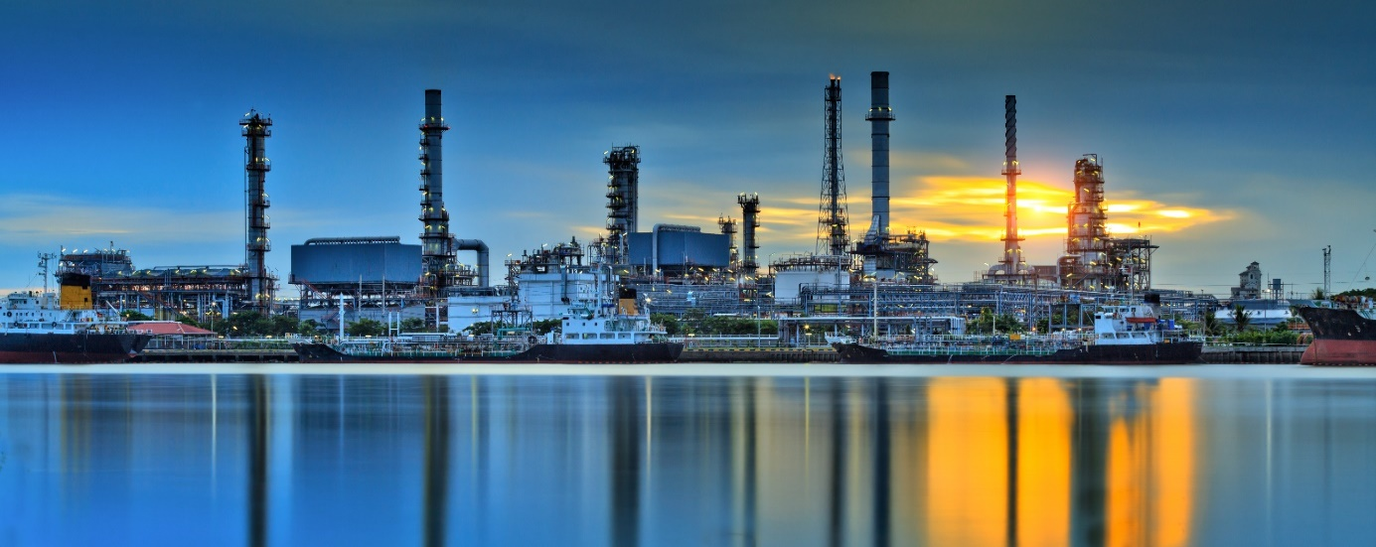

Slide 8
Prevention – reduced costs, less work, decreased risk.

Slide 9
Prevention – reduced costs, less work, decreased risk.
Timely pipeline leak detection is a significant business issue in view of a long history of catastrophic incidents and growing intolerance for such events. Leaks have severe safety, economic, environmental, and reputational effects. Leak detection is an essential component of pipeline risk management as it allows the operator to respond in time to the leaks to prevent further escalation of incidents. The scope includes leak detection for pipelines conveying various flowing fluids - gas, liquid, and multiphase flow. Pipeline environments include subsea and onshore. The higher the risk posed by the pipeline, the more sophisticated and important leak detection systems should be.

Slide 10
Prevention – reduced costs, less work, decreased risk.
Timely pipeline leak detection is a significant business issue in view of a long history of catastrophic incidents and growing intolerance for such events. Leaks have severe safety, economic, environmental, and reputational effects. Leak detection is an essential component of pipeline risk management as it allows the operator to respond in time to the leaks to prevent further escalation of incidents. The scope includes leak detection for pipelines conveying various flowing fluids - gas, liquid, and multiphase flow. Pipeline environments include subsea and onshore. The higher the risk posed by the pipeline, the more sophisticated and important leak detection systems should be.
The most damaging leaks occur below detection levels of most technologies and for long periods of time. Larger leak rates tend to occur under catastrophic failure conditions such as external force (e.g., third party, sabotage, ground movement) and avalanche crack failures. Larger leaks can be detected more quickly and will be located more precisely.

Slide 11
Creeping leaks may not be found at all by some methods due to the sensitivity limitations. The trade-offs involved between sensitivity and leak size are usually expressed in terms of uncertainty. One can imagine a scenario in which a smaller leak, rapidly detected and corrected, averted the creation of a larger, more dangerous leak. Small leak rates tend to occur due to corrosion (pinholes) or some design (mechanical connections) failure modes. The most damaging leaks occur elow detection levels for lengthy periods of time. An undetected leak of a 0,8 mm pinhole at 10 bars can be translated into a loss of more than 500.000 liters a year.

Slide 12


Slide 13
Requirements of regulations

Slide 14
Requirements of regulations
In Germany the operation of leak detection systems is regulated by the TRFL (Technical Rules for Pipelines). Even though it is a national standard, it has international acceptance as for example API1175 recommendations follow the TRFL.

Slide 15
Requirements of regulations
In Germany the operation of leak detection systems is regulated by the TRFL (Technical Rules for Pipelines). Even though it is a national standard, it has international acceptance as for example API1175 recommendations follow the TRFL.
The TRFL is published since 2003 by the German Federal Ministry for the Environment, Nature Conservation and Nuclear Safety, and is consolidated from three former regulations (TRbF301, TRGL and RRwS). In March 2024 an updated version has been issued, including a modification of all relevant leak detection paragraphs, originally intended only for application within the German federal territory. All regulations should be well known to pipeline operators especially in Europe.

Slide 16
TRFL (Technical Rules for Pipelines)

Slide 17
TRFL (Technical Rules for Pipelines)
11.4 Method for detecting leaking substances

Slide 18
TRFL (Technical Rules for Pipelines)
11.4 Method for detecting leaking substances
11.4.1 Procedure

Slide 19
TRFL (Technical Rules for Pipelines)
11.4 Method for detecting leaking substances
11.4.1 Procedure
11.4.1.1 Detection in steady-state and transient operating
conditions

Slide 20
The pipeline must be equipped with two different continuous technical processes that can detect the escape of pumped media in the stationary operating state. The discharge of pumped media in steady-state operating conditions. One of these methods or another must also be able to detect leaks during transient operating conditions. Suitable procedures are described in Annex VIII.

Slide 21
The pipeline must be equipped with two different continuous technical processes that can detect the escape of pumped media in the stationary operating state. The discharge of pumped media in steady-state operating conditions. One of these methods or another must also be able to detect leaks during transient operating conditions. Suitable procedures are described in Annex VIII.
The data security, accuracy and availability required for the detection of leaking fluids must be guaranteed. The methods for detecting leaking fluids may also use measurement data from other systems (e.g. supplying pipelines, downstream tanks). In the case of pipeline systems for oxygen and brine, one procedure is sufficient, provided that the failure of the process or of a part of the process is detected immediately and can be compensated by countermeasures.

Slide 22
The pipeline must be equipped with two different continuous technical processes that can detect the escape of pumped media in the stationary operating state. The discharge of pumped media in steady-state operating conditions. One of these methods or another must also be able to detect leaks during transient operating conditions. Suitable procedures are described in Annex VIII.
The data security, accuracy and availability required for the detection of leaking fluids must be guaranteed. The methods for detecting leaking fluids may also use measurement data from other systems (e.g. supplying pipelines, downstream tanks). In the case of pipeline systems for oxygen and brine, one procedure is sufficient, provided that the failure of the process or of a part of the process is detected immediately and can be compensated by countermeasures.
The countermeasures must be specified in operating instructions.

Slide 23
11.4.1.2 Detection during conveyor breaks
A procedure in accordance with Annex VIII must be used that can detect leaks during breaks in production. This may be dependent on the procedures according to sections 11.4.1.1 or 11.4.1.3

Slide 24
11.4.1.3 Detection of creeping leaks
A procedure in accordance with Annex VIII must be used to detect creeping leaks. This may be dependent on the procedures according to sections 11.4.1.1 or 11.4.1.2.

Slide 25
11.4.1.4 Leak location
A procedure in accordance with Annex VIII must ensure that leakage points (leaks) can be located quickly. Measures other than those listed in Annex VIII may also be used to precisely locate the leak.

Slide 26
11.4.2 Selection of methods, detectable leaks
The methods used to detect leaking liquids and the type and scope of the measuring equipment required for this purpose are to be selected in particular with regard to

Slide 27
11.4.2 Selection of methods, detectable leaks
The methods used to detect leaking liquids and the type and scope of the measuring equipment required for this purpose are to be selected in particular with regard to
a) Sensitivity (smallest detectable leakage rate and detection time),

Slide 28
11.4.2 Selection of methods, detectable leaks
The methods used to detect leaking liquids and the type and scope of the measuring equipment required for this purpose are to be selected in particular with regard to
a) Sensitivity (smallest detectable leakage rate and detection time),
reliability and

Slide 29
11.4.2 Selection of methods, detectable leaks
The methods used to detect leaking liquids and the type and scope of the measuring equipment required for this purpose are to be selected in particular with regard to
a) Sensitivity (smallest detectable leakage rate and detection time),
reliability and
c) accuracy of leak location

Slide 30
11.4.2 Selection of methods, detectable leaks
The methods used to detect leaking liquids and the type and scope of the measuring equipment required for this purpose are to be selected in particular with regard to
Sensitivity (smallest detectable leakage rate and detection time),
reliability and
accuracy of leak location
based on the chemical, physical, human and ecotoxic properties of the pumped medium (hazardous characteristics), the local conditions and the prevailing operating conditions (see also Annex VIII, including multiphase flow, free-fall sections, partial evaporation) in individual cases in accordance with Annex VIII must be selected. The selection must be evaluated by a test station.

Slide 31
Annex VIII

Slide 32
Annex VIII
Method for detecting leaking pumped liquid.

Slide 33
Annex VIII
Method for detecting leaking pumped liquid.
Preliminary remark.

Slide 34
Annex VIII
Method for detecting leaking pumped liquid.
Preliminary remark.
According to Part 1 Section 11.4 TRFL, methods must be used for pipelines that can detect leaking fluids (leak detection). The detection of a leak also requires the location of the leak.

Slide 35
Annex VIII
Method for detecting leaking pumped liquid.
Preliminary remark.
According to Part 1 Section 11.4 TRFL, methods must be used for pipelines that can detect leaking fluids (leak detection). The detection of a leak also requires the location of the leak.
In this appendix, the term "leakage" refers to the pumped medium escaping from a leaking point (leak) and the term "leak" refers to the leaking point through which the pumped medium escapes (leakage).

Slide 36
Various requirements are placed on the methods for detecting leaking substances, including those relating to response sensitivity, reliability and accuracy.

Slide 37
Various requirements are placed on the methods for detecting leaking substances, including those relating to response sensitivity, reliability and accuracy.
The description of sensitivity includes both (a) the smallest detectable leakage (as volume or mass flow) and (b) response time until the leak is detected. Both characteristics can be summarized as the amount of leakage (as volume or mass) until the leak alarm is triggered.

Slide 38
Various requirements are placed on the methods for detecting leaking substances, including those relating to response sensitivity, reliability and accuracy.
The description of sensitivity includes both (a) the smallest detectable leakage (as volume or mass flow) and (b) response time until the leak is detected. Both characteristics can be summarized as the amount of leakage (as volume or mass) until the leak alarm is triggered.
When specifying the smallest detectable leakage, attention must be paid to the reliability of the leak detection, by avoiding both false alarms and missed leakages (leaks without alarms).

Slide 39
Various requirements are placed on the methods for detecting leaking substances, including those relating to response sensitivity, reliability and accuracy.
The description of sensitivity includes both (a) the smallest detectable leakage (as volume or mass flow) and (b) response time until the leak is detected. Both characteristics can be summarized as the amount of leakage (as volume or mass) until the leak alarm is triggered.
When specifying the smallest detectable leakage, attention must be paid to the reliability of the leak detection, by avoiding both false alarms and missed leakages (leaks without alarms).
Finally, leak detection methods must be sufficiently accurate when indicating the leak location.

Slide 40
The following is a list of methods that can be used to detect escaping pumped liquid (leakage), taking into account the boundary conditions and comments listed there. The use of methods other than those listed is possible if sensitivity, reliability and accuracy are equivalent. No generally valid values can be given for the response sensitivity of the individual methods. This essentially depends on the following influencing factors, for example.

Slide 41

The following is a list of methods that can be used to detect escaping pumped liquid (leakage), taking into account the boundary conditions and comments listed there. The use of methods other than those listed is possible if sensitivity, reliability and accuracy are equivalent. No generally valid values can be given for the response sensitivity of the individual methods. This essentially depends on the following influencing factors, for example.
Chemical and physical properties of the pumped media (for example, aggregate state in the pipeline system and on release, compressibility and viscosity of the pumped medium),

Slide 42

The following is a list of methods that can be used to detect escaping pumped liquid (leakage), taking into account the boundary conditions and comments listed there. The use of methods other than those listed is possible if sensitivity, reliability and accuracy are equivalent. No generally valid values can be given for the response sensitivity of the individual methods. This essentially depends on the following influencing factors, for example.
Chemical and physical properties of the pumped media (for example, aggregate state in the pipeline system and on release, compressibility and viscosity of the pumped medium),
Type of pipeline system (e.g. only one pipeline from A to B, interconnected, ring or network system, length and diameter of the pipeline or pipelines),

Slide 43

Type of pipeline operation (e.g. changes in pressure, volume, temperature; simultaneous or staggered withdrawal and injection at one or more points, reversal of the direction of flow in the pipeline or in parts of a pipeline system)

Slide 44

Type of pipeline operation (e.g. changes in pressure, volume, temperature; simultaneous or staggered withdrawal and injection at one or more points, reversal of the direction of flow in the pipeline or in parts of a pipeline system)
The type of flow in the pipeline (e.g. single-phase or multi-phase flow) and

Slide 45

Type of pipeline operation (e.g. changes in pressure, volume, temperature; simultaneous or staggered withdrawal and injection at one or more points, reversal of the direction of flow in the pipeline or in parts of a pipeline system)
The type of flow in the pipeline (e.g. single-phase or multi-phase flow) and
Type and scope of the measuring equipment and quality of the signals

Slide 46
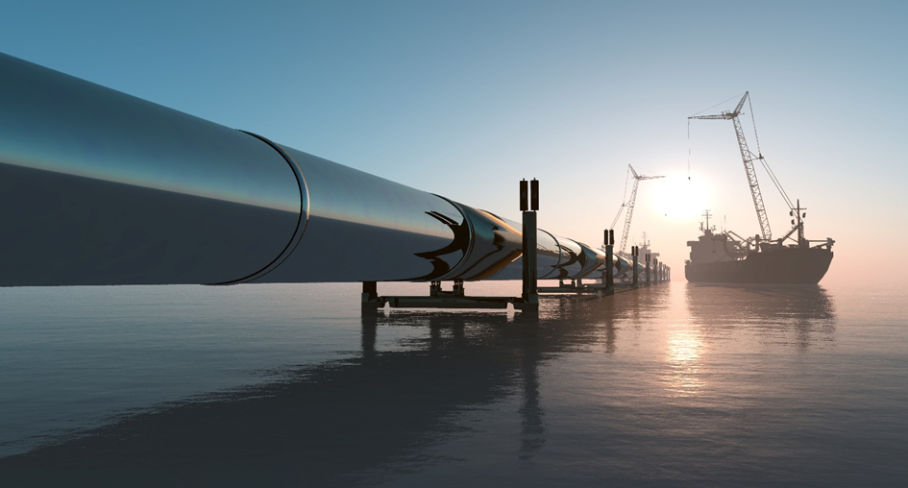

Slide 47
Overview of the various processes and the technology behind them
VIII 1 Balancing – Measurement
VIII 1.1 Procedure for volume and mass balancing without compensation
VIII 1.1.1 Mass balancing method
VIII 1.1.2 Mass differential method
VIII 1.2 Mass balancing method with compensation
VIII 1.2.1 RTTM Method (Real Time Transient Model)
VIII 1.2.2 E-RTTM Method (Extended Real Time Transient model)
VIII 2 Shock Wave Methods
VIII 2.1 Pressure Wave Method
VIII 2.2 Pressure Flow Method

Slide 48
Overview of the various processes and the technology behind them
VIII 3 Fibre Optical Methods
VIII 3.1 Distributed Temperature Sensing
VIII 3.2 Acoustic Measurements
VIII 4 Acoustic Methods / Measurements
VIII 5 Cable Based conductivity measurements
VIII 6 Pressure Temperature measurement
VIII 7 Pressure Differential Method
VIII 8 Diffusion hose System
VIII 9 Leak Detection Pigging
VIII 10 Gas Detection Devises

Slide 49
Overview of the various processes and the technology behind them
VIII 10 Gas Detection Devises
VIII 11 Airial Surveillance
VIII 12 Gradient Intersection Method
All of the above information is taken from the announcement in the Federal Gazette (www.bundesanzeiger.de). Publication of Wednesday, March 13, 2024

Slide 50


Slide 51
Facts
A lot of different approaches had been taken to address the problem of detecting and reliably locating leaks and at least have a quick response time. The physical impact of a leak can be of different nature: - Temperature changes at the leak - Acoustics produced by the leak - Pressure waves travelling through the line - Pressure changes in the line - Differences in input and output - Concentration of medium in the soil around the leak. This leads to a lot of technical possibilities to search for leaks and locate them. Most common is an online pipeline monitoring that can detect leaks by comparing the actual operation parameters like throughput and pressure / temperature with mathematical models of the line to find deviations. As with every technology, there are benefits and drawbacks.

Slide 52
The most important thing is that these systems provide surveillance of the pipeline 24/7/365 and have different options to monitor the pipeline operation not only for leaks but also for operation parameters. On the other hand, those systems are not capable to detect very small leaks during normal pipeline operation. These leaks can thus spill for weeks or even months and will not be recognized until they have grown to a detectable size. The threshold is normally measured in m³/h and almost always in relation to the throughput whereas specialized leak detection systems like leak detection pigs measure in l/h and independent of the line size.

Slide 53
The most important thing is that these systems provide surveillance of the pipeline 24/7/365 and have different options to monitor the pipeline operation not only for leaks but also for operation parameters. On the other hand, those systems are not capable to detect very small leaks during normal pipeline operation. These leaks can thus spill for weeks or even months and will not be recognized until they have grown to a detectable size. The threshold is normally measured in m³/h and almost always in relation to the throughput whereas specialized leak detection systems like leak detection pigs measure in l/h and independent of the line size.
On the contrary they can only provide a surveillance of the line when they perform a run. That leads to the combination of different technologies to provide a leak monitoring that can detect small leaks but also guarantees round the clock leak detection for the lines.

Slide 54
Other technologies for example use fibre optics along the lines to detect temperature changes or in the latest generations even sound signatures of leaks.

Slide 55
Other technologies for example use fibre optics along the lines to detect temperature changes or in the latest generations even sound signatures of leaks.
This is also a very precise system when it comes to detection and location of leaks but can hardly be installed on existing pipelines that are already buried underground.

Slide 56
Other technologies for example use fibre optics along the lines to detect temperature changes or in the latest generations even sound signatures of leaks.
This is also a very precise system when it comes to detection and location of leaks but can hardly be installed on existing pipelines that are already buried underground.
If it is possible to shut the line down for a certain time, normally pressure tests are also a clever way to detect leaks but do not provide good location features.

Slide 57
Other technologies for example use fibre optics along the lines to detect temperature changes or in the latest generations even sound signatures of leaks.
This is also a very precise system when it comes to detection and location of leaks but can hardly be installed on existing pipelines that are already buried underground.
If it is possible to shut the line down for a certain time, normally pressure tests are also a clever way to detect leaks but do not provide good location features.
But detecting the leaks is not everything as these spots also need to be located precisely. Gottsberg leak detection pigs can provide exact results as they are travelling past these points and can therefor locate them exactly.

Slide 58
To have an all over monitoring system for leakages it is necessary to combine different Technologies to provide a suitable solution for all operation modes and leak cases. That is why also the problem of pipeline product theft, and even sabotage needs to be considered when the choice for the leak detection technology is made especially because these technologies need to be adapted to the theft methods which are evolving quickly. In most cases the holes drilled for illegal tapping and product theft are also below the threshold of online monitoring and in some cases even below the ones of MFL or UT wall thickness measurements. There are much more technologies and methods to ensure the leak tightness of pipelines but none of them can provide a one for all solution. In best case two different online monitoring systems that work permanently during stationary and transient conditions combined with intelligent leak pigging in sufficient temporally intervals should be a solution that works.

Slide 59
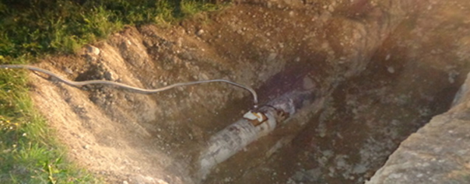
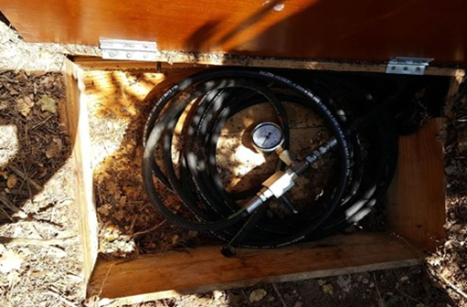
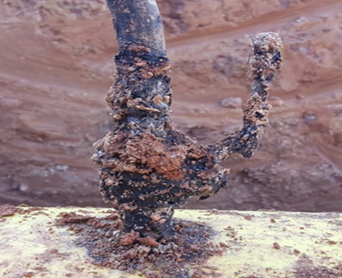

Slide 60
Why using Gottsberg Leak Detection System
There are a lot of different technical options to address the issue. One of the best is using leak detection pigs that are running inside of the line and are able to detect even the smallest product losses by means of acoustic data evaluation. It is the duty of technology providers to constantly develop and improve their methods to keep up with their opponents. But as the criminals are quickly reacting to the efforts the pipeline operators are taking to catch them, this technology can find even the smallest amounts of product loss you could not find with other technologies.

Slide 61
Why using Gottsberg Leak Detection System
There are a lot of different technical options to address the issue. One of the best is using leak detection pigs that are running inside of the line and are able to detect even the smallest product losses by means of acoustic data evaluation. It is the duty of technology providers to constantly develop and improve their methods to keep up with their opponents. But as the criminals are quickly reacting to the efforts the pipeline operators are taking to catch them, this technology can find even the smallest amounts of product loss you could not find with other technologies.
The tools are running through the line, propelled by the flow during absolute normal operation and record all noises in the line. After processing the data, the analysis starts and leaks can clearly be identified and distinguished from all other noises. Also a precise location with an accuracy of 1-5 m can be done within the first run and without any external tools needed. Drawback of this option is that the tool needs to pass the point of leakage, sabotage or illegal tapping while product is siphoned from the line.

Slide 62
● Only system suitable for smallest leaks (6.8 l/hr)

Slide 63
● Only system suitable for smallest leaks (6.8 l/hr)
● Locating of the leak is done during run

Slide 64
● Only system suitable for smallest leaks (6.8 l/hr)
● Locating of the leak is done during run
● False alarms are reliably avoided with noise filters and 128 channel frequency analysis

Slide 65
● Only system suitable for smallest leaks (6.8 l/hr)
● Locating of the leak is done during run
● False alarms are reliably avoided with noise filters and 128 channel frequency analysis
● Run results within a few hours

Slide 66
● Only system suitable for smallest leaks (6.8 l/hr)
● Locating of the leak is done during run
● False alarms are reliably avoided with noise filters and 128 channel frequency analysis
● Run results within a few hours
● The only ILI tool certified for ATEX zone 0 (German TÜV approval)

Slide 67
● Only system suitable for smallest leaks (6.8 l/hr)
● Locating of the leak is done during run
● False alarms are reliably avoided with noise filters and 128 channel frequency analysis
● Run results within a few hours
● The only ILI tool certified for ATEX zone 0 (German TÜV approval)
● Operation is not affected in any way

Slide 68
● Only system suitable for smallest leaks (6.8 l/hr)
● Locating of the leak is done during run
● False alarms are reliably avoided with noise filters and 128 channel frequency analysis
● Run results within a few hours
● The only ILI tool certified for ATEX zone 0 (German TÜV approval)
● Operation is not affected in any way
● Can be used for several pipelines by switching the chassis

Slide 69
● Only system suitable for smallest leaks (6.8 l/hr)
● Locating of the leak is done during run
● False alarms are reliably avoided with noise filters and 128 channel frequency analysis
● Run results within a few hours
● The only ILI tool certified for ATEX zone 0 (German TÜV approval)
● Operation is not affected in any way
● Can be used for several pipelines by switching the chassis
● Handling and operation is very easy

Slide 70
GLD Portfolio

Slide 71
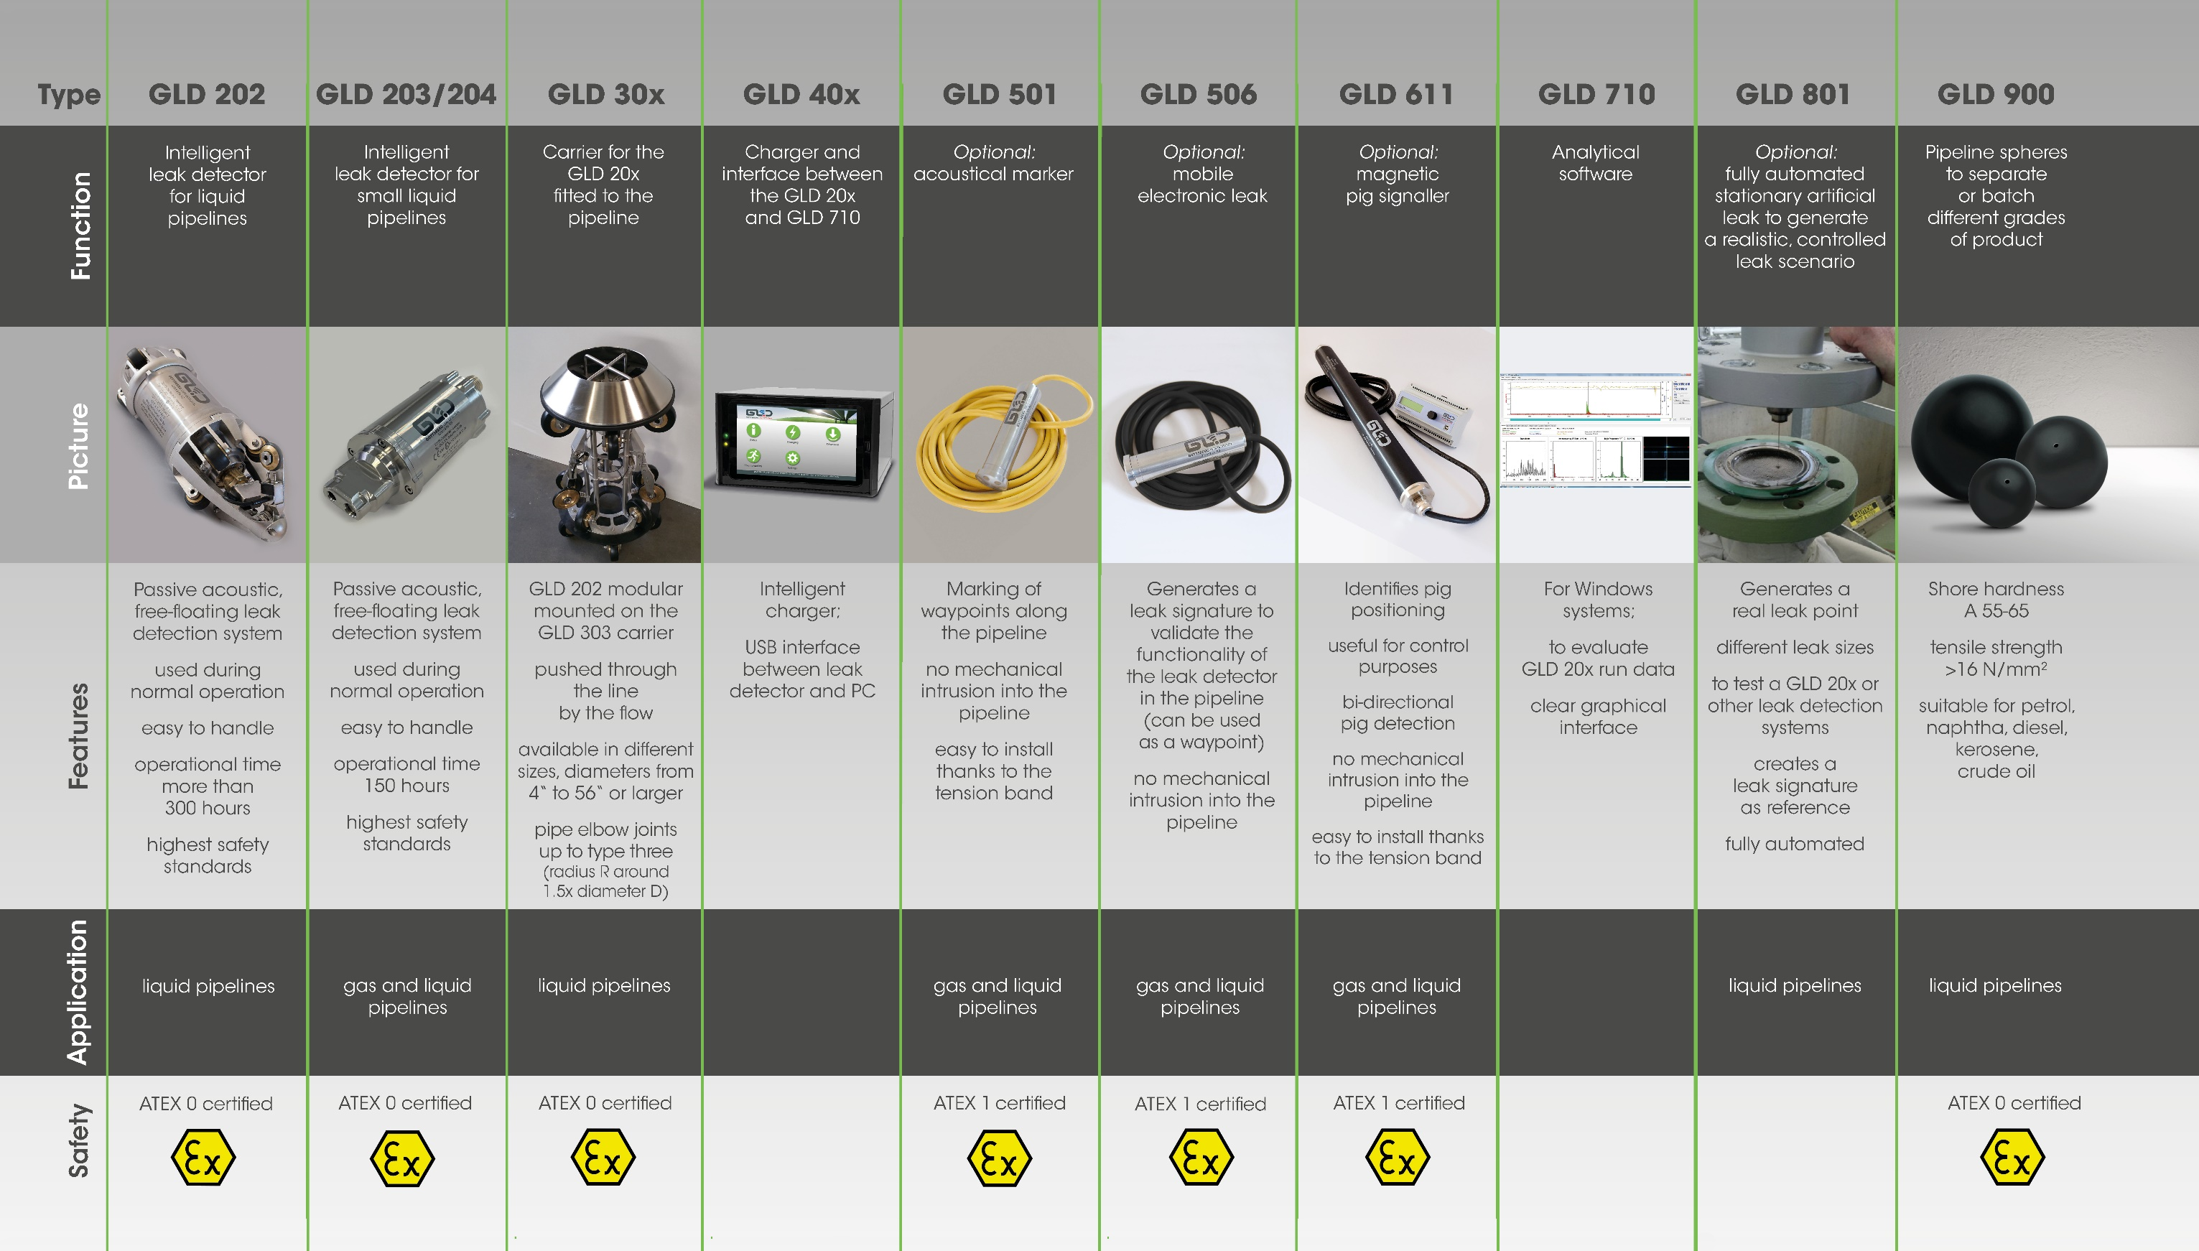

Slide 72
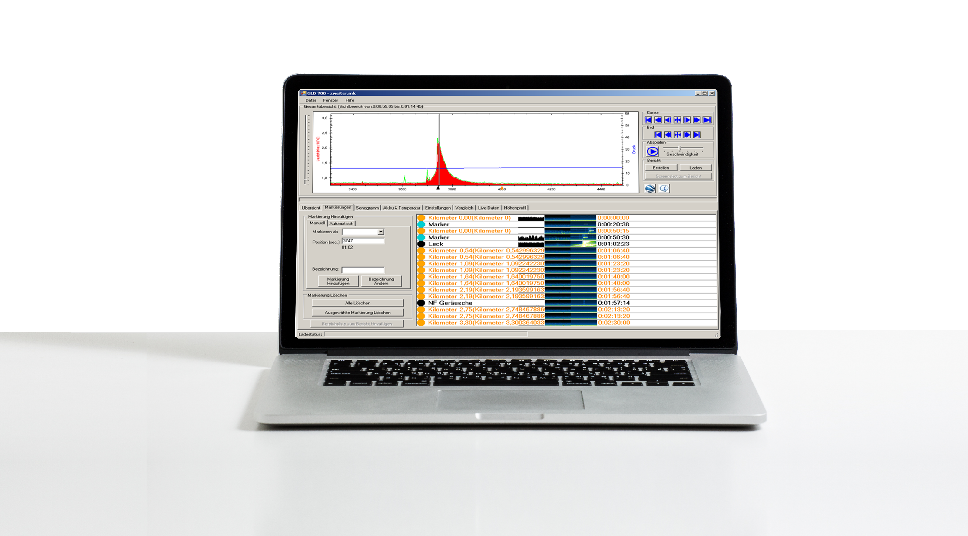
Automated search for interesting regions

Slide 73
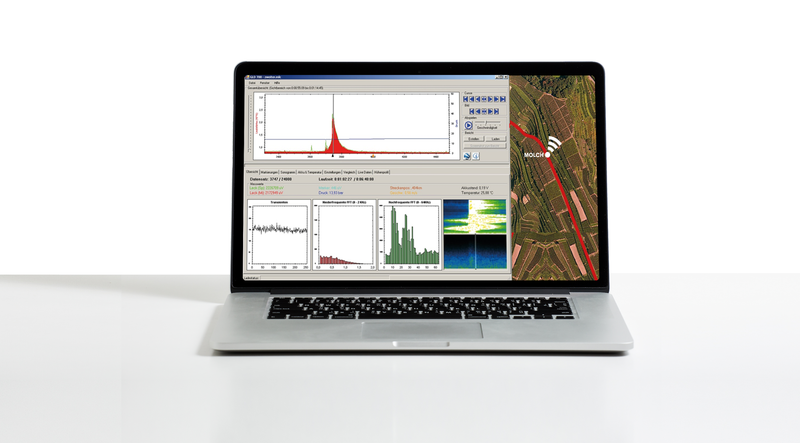
Automated search for interesting regions

Slide 74
Pipeline Insurance, potential of cost savings
In the last few decades there has been an explosion in the importance of pipelines as a way of transportation of oil, gas, water and other materials. Pipelines are considered safer than alternative forms of transport in many cases and their use has spread around the world into all types of terrain.

Slide 75
Pipeline Insurance, potential of cost savings
In the last few decades there has been an explosion in the importance of pipelines as a way of transportation of oil, gas, water and other materials. Pipelines are considered safer than alternative forms of transport in many cases and their use has spread around the world into all types of terrain.
The Oil and gas insurance market is extremely concentrated and large international corporations such as Munich Re, Lloyd, Allianz, AXA XL, Zurich and Liberty Mutual collectively control most of the oil and gas insurance market. Then come small, specialized insurance companies such as Starr and Fairfax as well as Chinese companies (China Pacific Insurance Co., Ping An, People’s Insurance Company of China). The top 10 oil and gas insurers share around 70 percent of the market.

Slide 76
To understand the saving potential, you need to know the following.

Slide 77
To understand the saving potential, you need to know the following.
There are several types or "classes" of insurance, which are likely to be of relevance in the pipeline field: construction; property damage; business interruption and liability.

Slide 78
To understand the saving potential, you need to know the following.
There are several types or "classes" of insurance, which are likely to be of relevance in the pipeline field: construction; property damage; business interruption and liability.
In the early 20th century, much of the premium for a policy is determined simply by the statistics of the pipeline. Age and type, products, location topographical and meteorological conditions.

Slide 79
To understand the saving potential, you need to know the following.
There are several types or "classes" of insurance, which are likely to be of relevance in the pipeline field: construction; property damage; business interruption and liability.
In the early 20th century, much of the premium for a policy is determined simply by the statistics of the pipeline. Age and type, products, location topographical and meteorological conditions.
The perils that mostly concerned an insurer in the past included earthquakes, tsunamis, volcanoes, storms floods, landslides, impact damage, political risks and of course fire and explosions.

Slide 80
To understand the saving potential, you need to know the following.
There are several types or "classes" of insurance, which are likely to be of relevance in the pipeline field: construction; property damage; business interruption and liability.
In the early 20th century, much of the premium for a policy is determined simply by the statistics of the pipeline. Age and type, products, location topographical and meteorological conditions.
The perils that mostly concerned an insurer in the past included earthquakes, tsunamis, volcanoes, storms floods, landslides, impact damage, political risks and of course fire and explosions.
Pipeline routes pass through different countries, jurisdictions and cultures and knowledge of each is vital when facing the difficulties caused by a major incident.

Slide 81
To understand the saving potential, you need to know the following.
There are several types or "classes" of insurance, which are likely to be of relevance in the pipeline field: construction; property damage; business interruption and liability.
In the early 20th century, much of the premium for a policy is determined simply by the statistics of the pipeline. Age and type, products, location topographical and meteorological conditions.
The perils that mostly concerned an insurer in the past included earthquakes, tsunamis, volcanoes, storms floods, landslides, impact damage, political risks and of course fire and explosions.
Pipeline routes pass through different countries, jurisdictions and cultures and knowledge of each is vital when facing the difficulties caused by a major incident.
Basically, nothing has changed much, it’s only that one aspect has been added significantly in addition. Which technology combinations optimize the Pipeline Safety and what has been done to protect the pipeline from any potential risk.

Slide 82


Slide 83
Example from GOTTSBERG technology
After a major incident on a pipeline, our technology was deployed for a new customer. Some pipeline sections were now inspected on a monthly or even weekly basis. As a result, our customer was able to avoid a massive increase in premiums to their insurance company, and the potential savings far exceeded the investment costs in our technology in the first year. Visit us at our stand E15 to find out more.

Slide 84



Slide 85
Conclusions
There is no one technology for leak detection that covers all areas, but a decisive advantage can be gained by combining different technologies. When it comes to detecting pinhole leaks and their precise location, Gottsberg Leak Detection’s technology certainly has the potential to be a game changer.

Slide 86
Conclusions
There is no one technology for leak detection that covers all areas, but a decisive advantage can be gained by combining different technologies. When it comes to detecting pinhole leaks and their precise location, Gottsberg Leak Detection’s technology certainly has the potential to be a game changer.
Regular dialogue and an open relationship will give owners and operators the maximum benefit from their expenditure on insurance premiums. It will also be a sound investment should a major loss occur when their insurance coverage might prove vital to their survival.

Slide 87
Thank you
for your attention!

